Slide 1
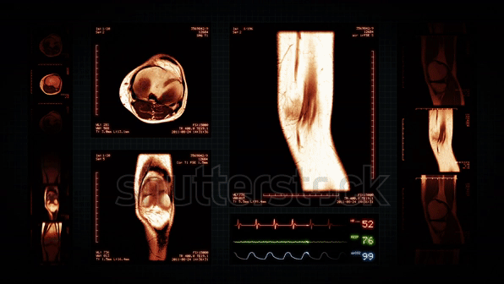

Knee MRI Classification
Team Overview:
Team Lead : Imran
Sai Sudha
Smritee Narain
Team strength : 14 members

Slide 2
Project milestone and attendance tracker
Gantt chart for project timeline tracker project milestones
2. Attendance tracker Attendance tracker
Notes:
To track project day-to-day activities we are using Gantt Chart and we do have our own tracker to track all the work assignments and meetings. All the worked are Assigned through Internship Dashboard and after compilation we approve the work after referencing to the Project drive Task tracker folder.

Slide 3
Abstract
Magnetic resonance imaging (MRI) of the knee is the preferred method for diagnosing knee injuries. However, interpretation of knee MRI is time-intensive and subject to diagnostic error and variability. An automated system for interpreting knee MRI could prioritize high-risk patients and assist clinicians in making diagnoses. Deep learning methods, in being able to automatically learn layers of features, are well suited for modelling the complex relationships between medical images and their interpretations.

Slide 4
High-Level Document Final HLD
The HLD documentation presents the structure of the system, such as the predictive model used, application architecture (layers), application flow (Navigation), and technology architecture. The HLD uses non-technical to mildly technical terms which should be understandable to the administrators of the system.
High-Level Objectives
To enable reading/loading of MRI Image by the user.
To pre-process the MRI image for enhanced quality before further processing.
To classify the image into normal and abnormal using Deep Learning Techniques
If abnormal, predicting the type and location of the injury.
To perform statistical analysis of the results and display them in a user-friendly manner.
Notes:
Our HLD is already submitted under review with Ineuron Project team.

Slide 5
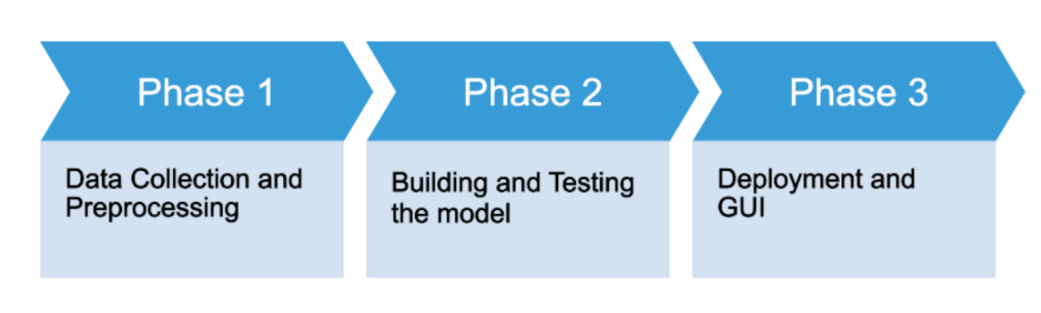
Low-Level Document LLD
This document captures the different workflows involved to build the solution, exceptions in the workflows and
any assumptions that have been considered. Changes to this business process may constitute a request for
change and will be subject to the agreed agility program change procedures.
Notes:
LLD is also completion phase and needed few updates regarding our Dashboard system and wireframe.

Slide 6
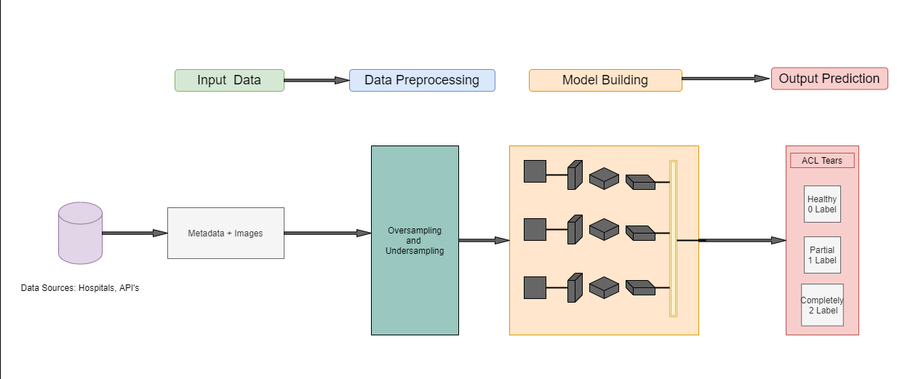
ARCHITECTURE DOCUMENT Architectures
Notes:
We have Architecture design document for conceptual architecture, High level design architecture, CNN model architecture and Model testing architecture.

Slide 7
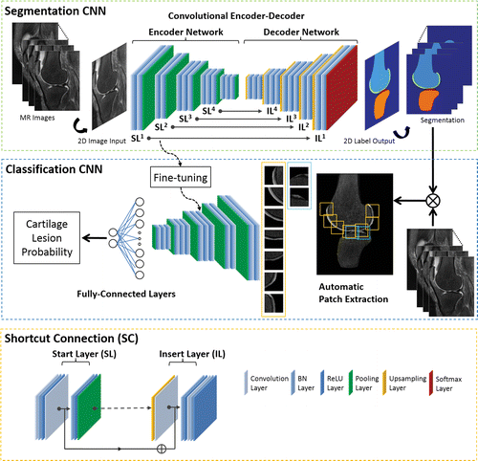
CNN Architecture
CNN based approaches:
VGG16
AlexNet
RestNet
Inception
DenseNet
3D CNN
Notes:
MRI acceleration using deep learning (DL) convolutional neural networks (CNNs) is a novel technique with great promise. Increasing the number of convolutional layers may allow for more accurate image reconstruction. Nowadays researchers are using deep learning with a model of CNN and its architectures in several applications. The CNNs architectures have an input layer and an output layer, and there are also many convolutional layers, pooling layers, rectified linear unit layers, dense layers and dropout layers [17,18]. The CNN shows huge success in the analysis of radiography X-rays in the knee osteoarthritis automatically, as there is no need of image pre-processing [19,20]. However, X-rays have not been able to improve upon three classes of knee ACL detection, as compared to MR images.

Slide 8
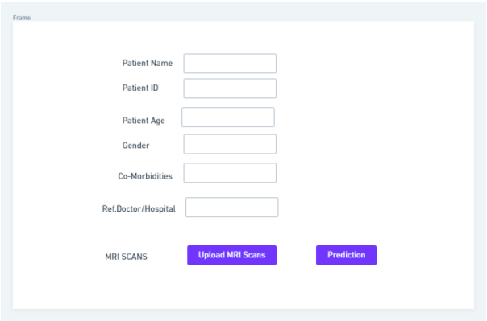
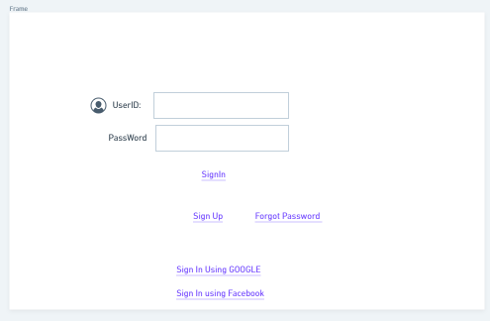
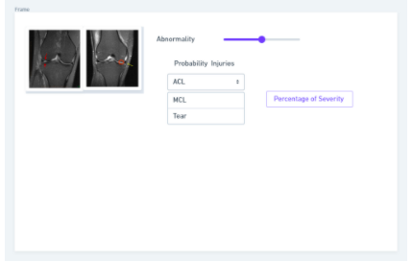
Wireframe-GUI screen
Wireframe Highlights:
Signup screen
Login to Portal
Upload MRI scan
Predictions
Percentage of Severity
Notes:
We have designed the GUI screen via wireframe which has user’s signup screen. User can Login in to the portal and upload their MRI scan and fill the form on the screen and click on the prediction button. This will call for the prediction Algorithm model in the backend and it will give us the desired output in terms of the type of injury and the severity.

Slide 9
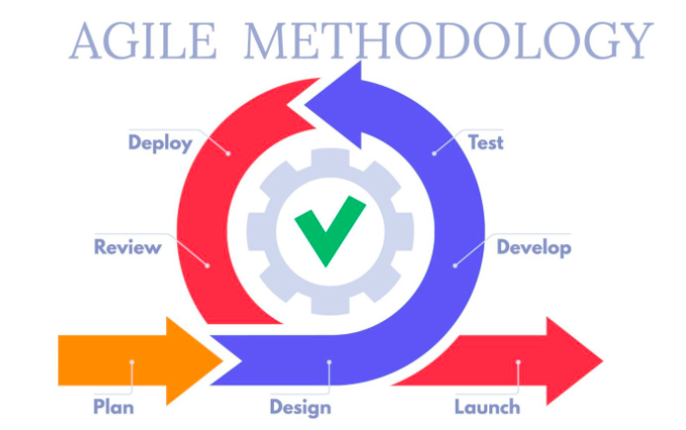
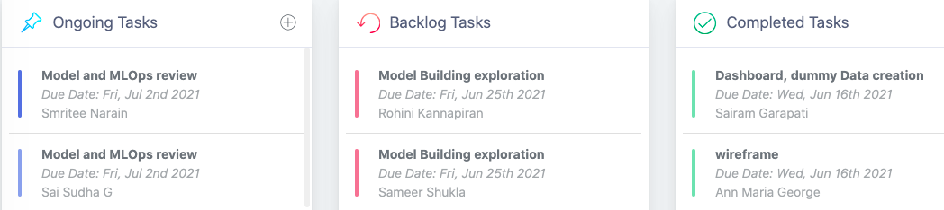
Agile methodology steps reached till,
Data Collection: MRNET and Kaggle datasets collected (data_ref)
Dummy data creation for dashboard development ( Dashboard)
Model building and evaluation: Started implementing the model (CNN model with MRNET)
Task Tracking system
Notes:
In Planning phase we have completed HLD, LLD, Architecture and UI designs and strategies for the project.
We are developing the Deep Learning model based on CNN Architecture and Evaluation system.
We have designed and created the dashboard system which can give the overview of the descriptive analysis of the datasets based on dummy datasets.

Slide 10
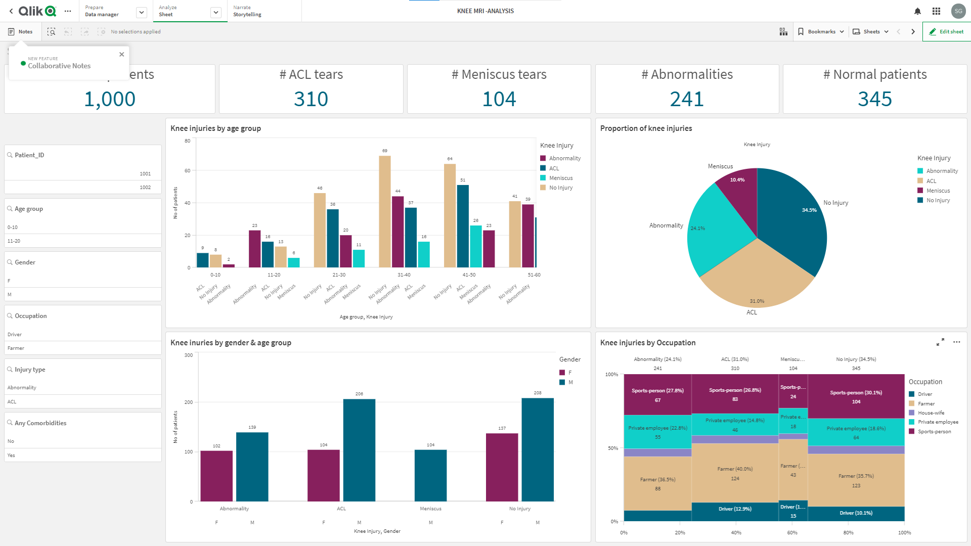
Notes:
The dashboard gives an overview of the descriptive side of the data. It will project information about Knee Injuries by age group, Proportion of the knee injury, knee injury by gender, age group and occupation. It summarizes and gives us visualization of the data based on the main characteristics and features.

Slide 11
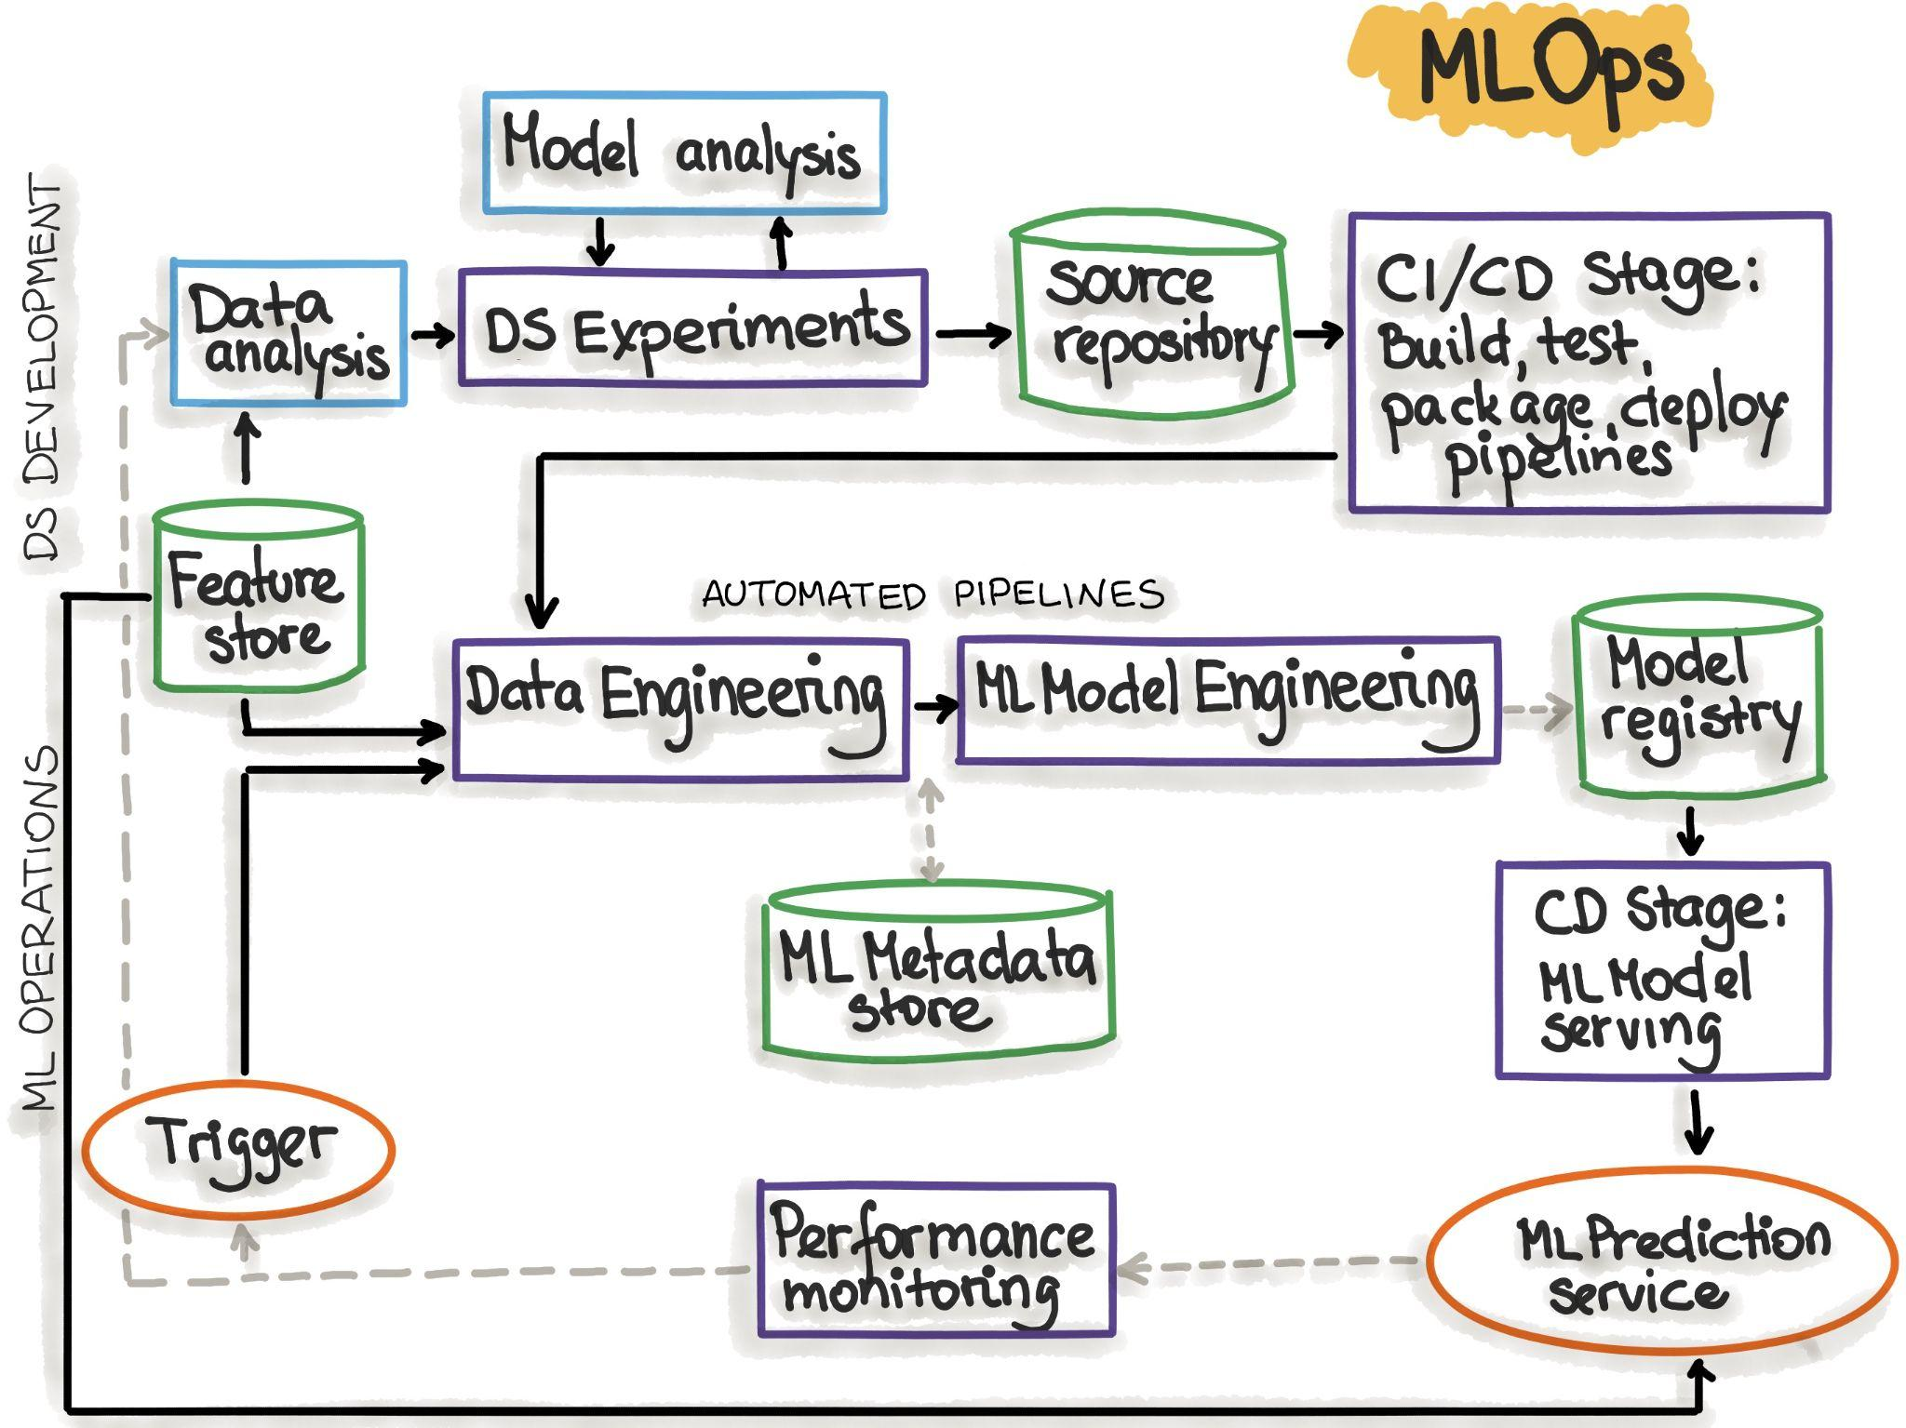
MLOPS (implementation steps )
MLOPS Highlights:
Create reproducible models and reusable training Pipelines
Simplify model packaging, validation, and deployment for quality control,A/B testing, and more
Explain & observe behaviour and automate the retraining process
Notes:
MLops is on eof the techniques for implementing and automating continuous integration (CI), continuous delivery (CD), and continuous training (CT) for machine learning (ML) systems.
Usage:
Model reproducibility, Model Validation, Model deployment, Model retraining

Slide 12
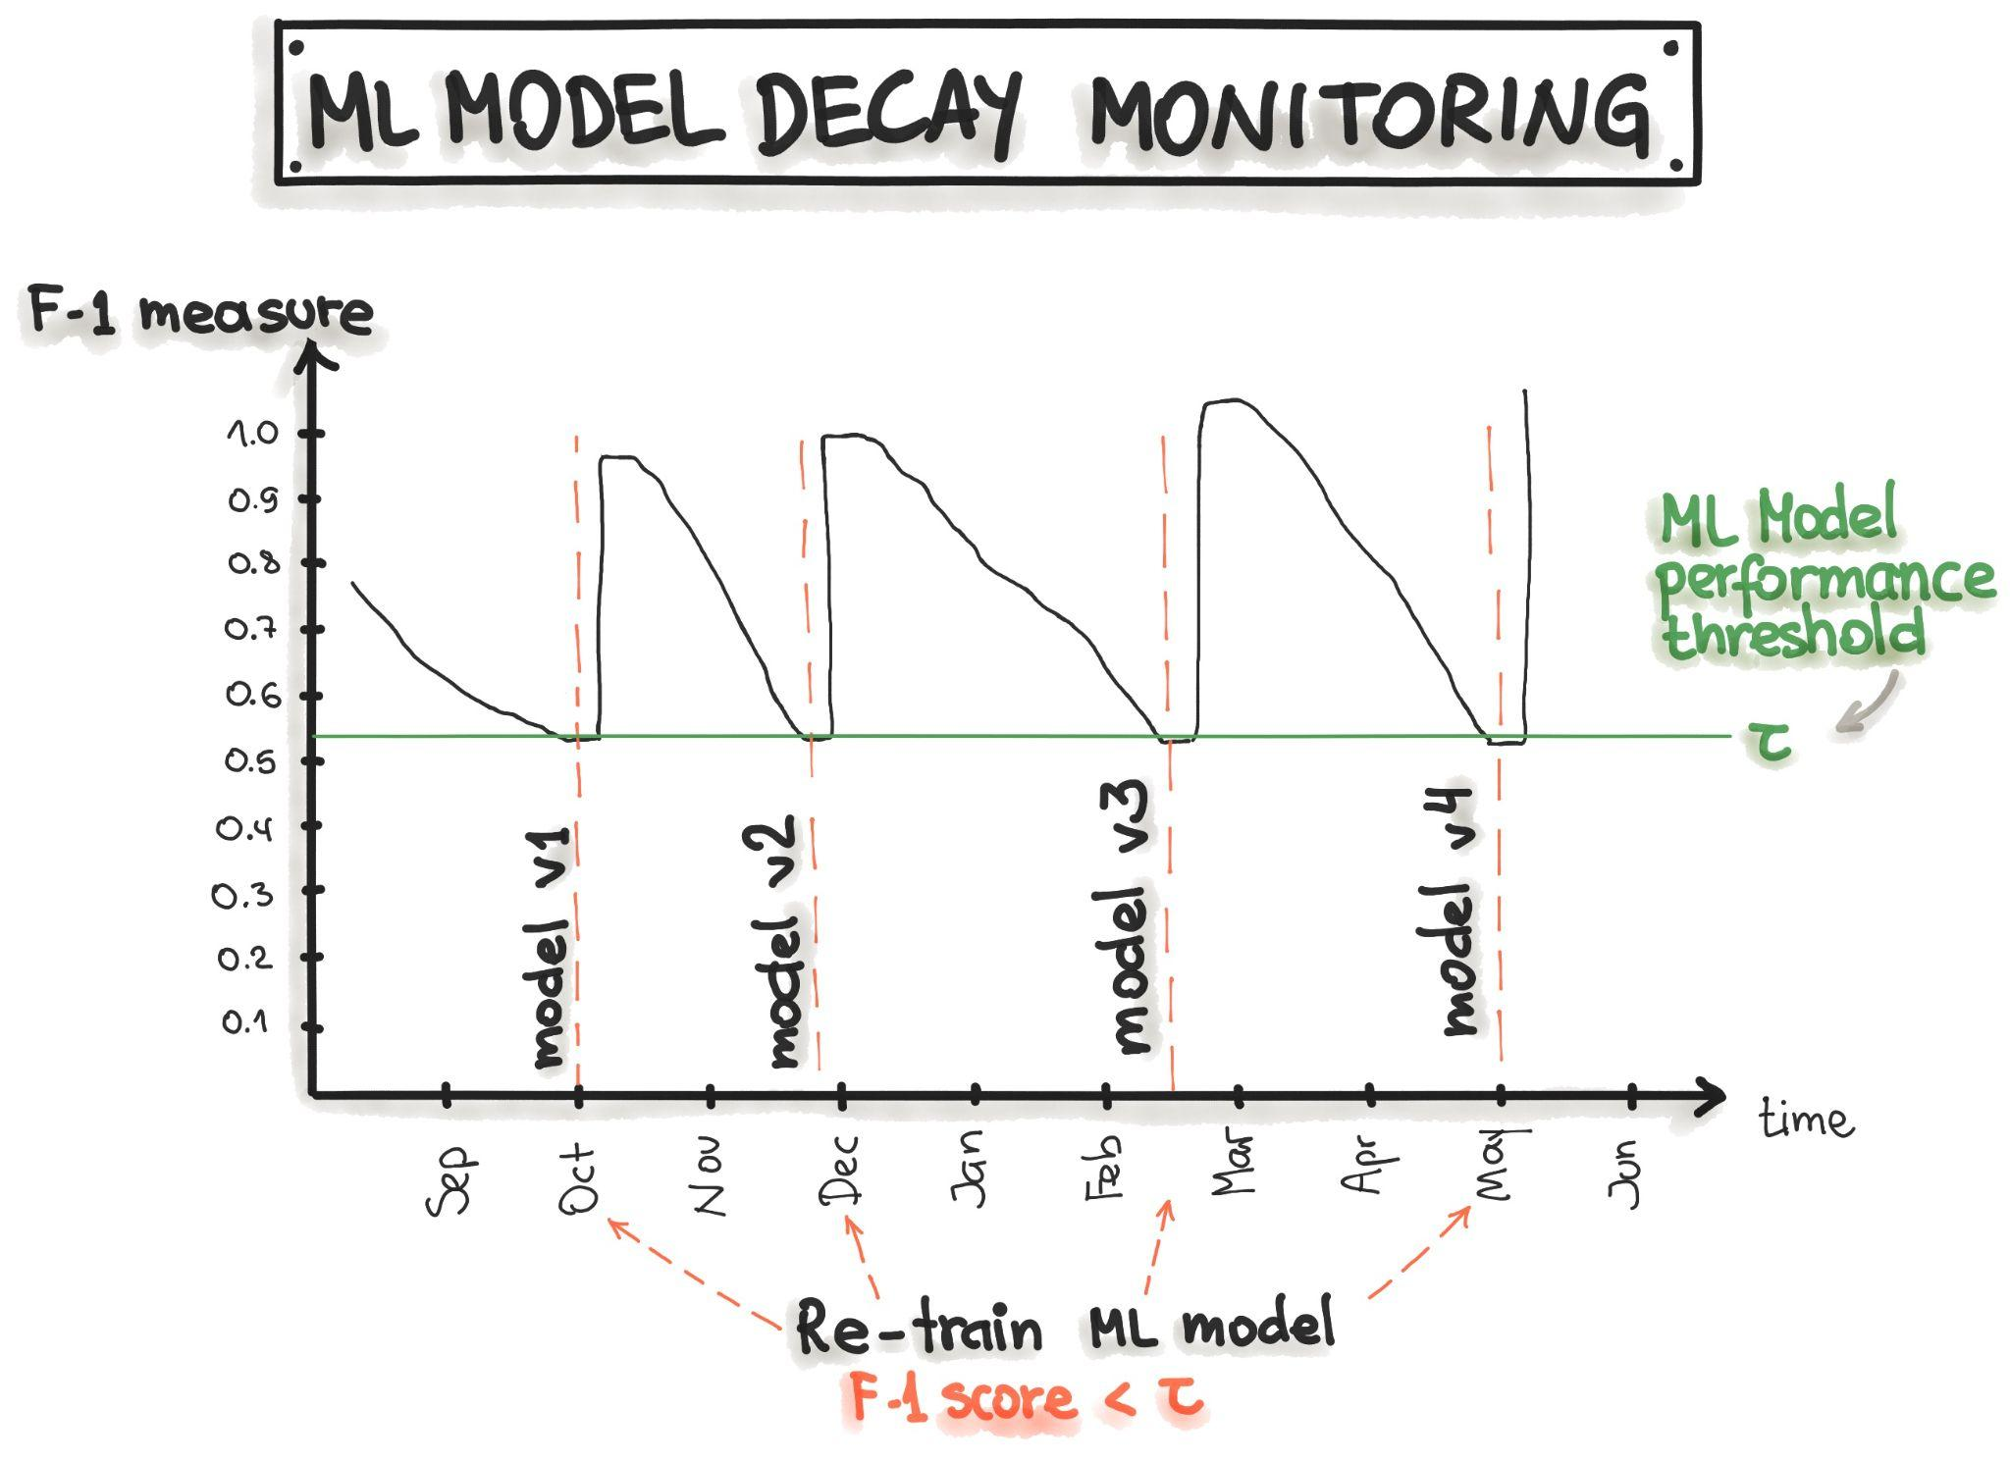
Retraining Approach:
Notes:
The picture below shows that the model monitoring can be implemented by tracking the precision, recall, and F1-score of the model prediction along with the time. The decrease of the precision, recall, and F1-score triggers the model retraining, which leads to model recovery.

Slide 13
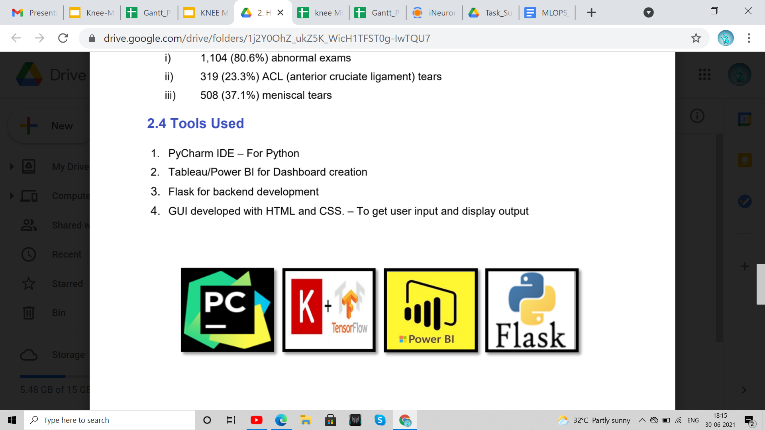
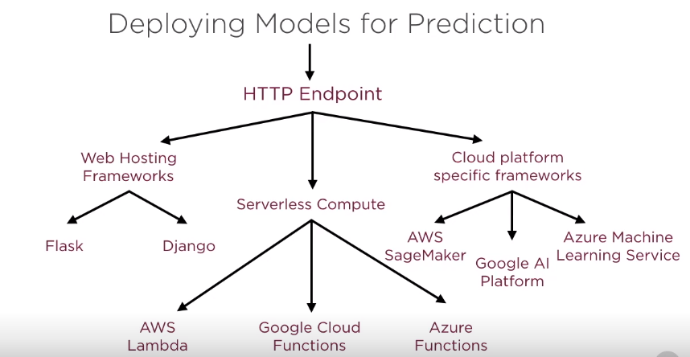
Tools to be used for developing modular coding
Notes:
We are using google colaboratory for Initial model Exploration.
Final Model will be developed in Pycharm with modular coding and all the coding standards will be followed.

Slide 14
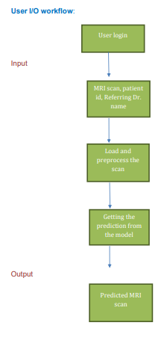
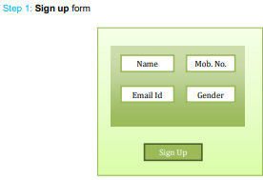
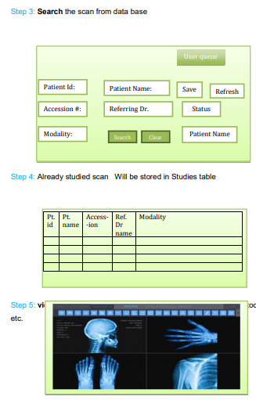
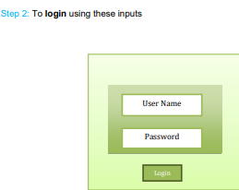
UI Screens flow
Notes:
UI screen flow entails signup forms, login screen , search option from database, Image upload and prediction.

Slide 15


